Slide 1


Lecture 30
Produced by Dr. Worldwide
Welcome to the 305
~
~

Slide 2

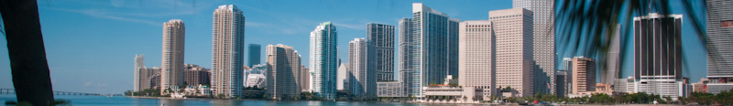


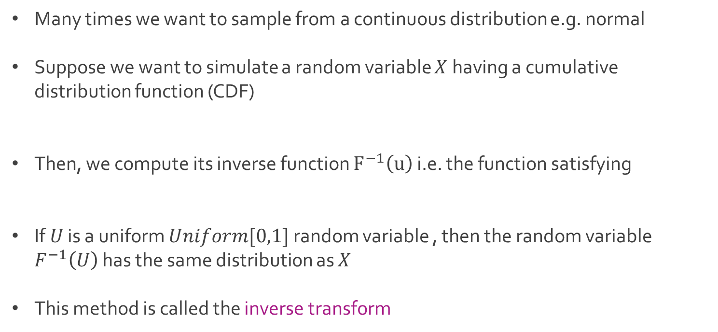
Simulation for Continuous
Many times we want to sample from a continuous distribution e.g. normal
Suppose we want to simulate a random variable $X$ having a cumulative distribution function (CDF)
Then, we compute its inverse function $F^{−1}\left(u\right)$ i.e. the function satisfying
If $U$ is a uniform $Uniform[0,1]$ random variable , then the random variable $F^{−1}\left(U\right)$ has the same distribution as $X$
This method is called the inverse transform

Slide 3

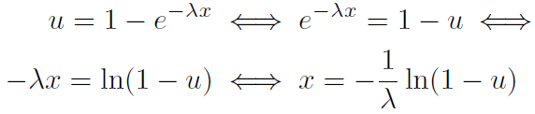
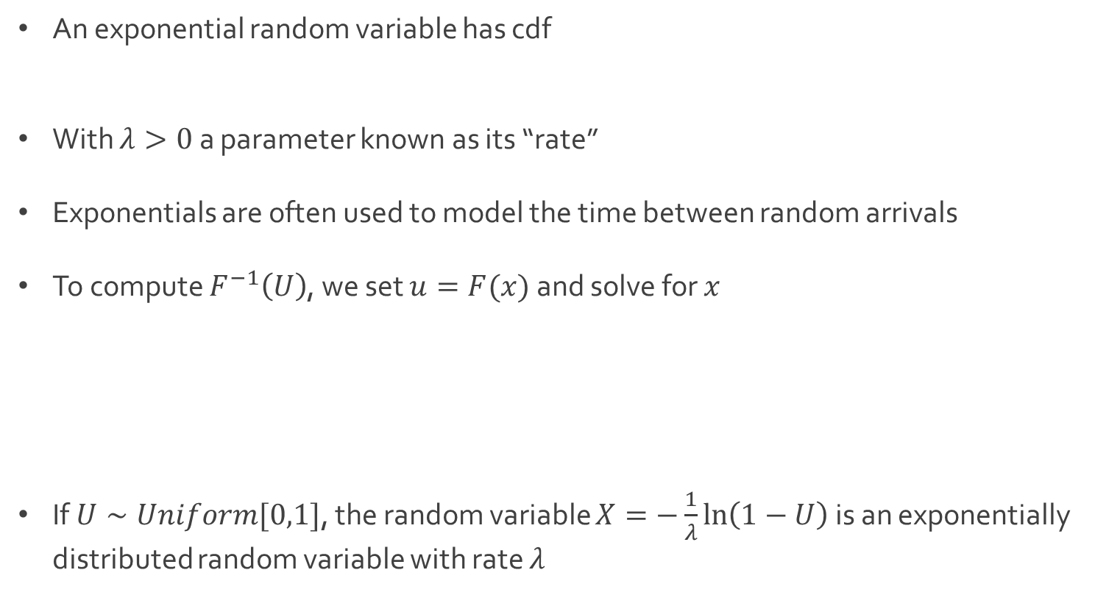
Exponential Simulation
An exponential random variable has cdf
With $λ>0$ a parameter known as its “rate”
Exponentials are often used to model the time between random arrivals
To compute $F^{−1}\left(U\right)$, we set $u=F(x)$ and solve for $x$
If $U∼Uniform[0,1]$, the random variable $X=−\frac{1}{λ}\ln\left(1−U\right)$ is an exponentially distributed random variable with rate $λ$

Slide 4

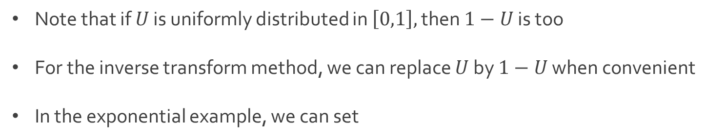
Exponential Simulation
Note that if $U$ is uniformly distributed in $\left[0,1\right],$ then $1−U$ is too
For the inverse transform method, we can replace $U$ by $1−U$ when convenient
In the exponential example, we can set

Slide 5
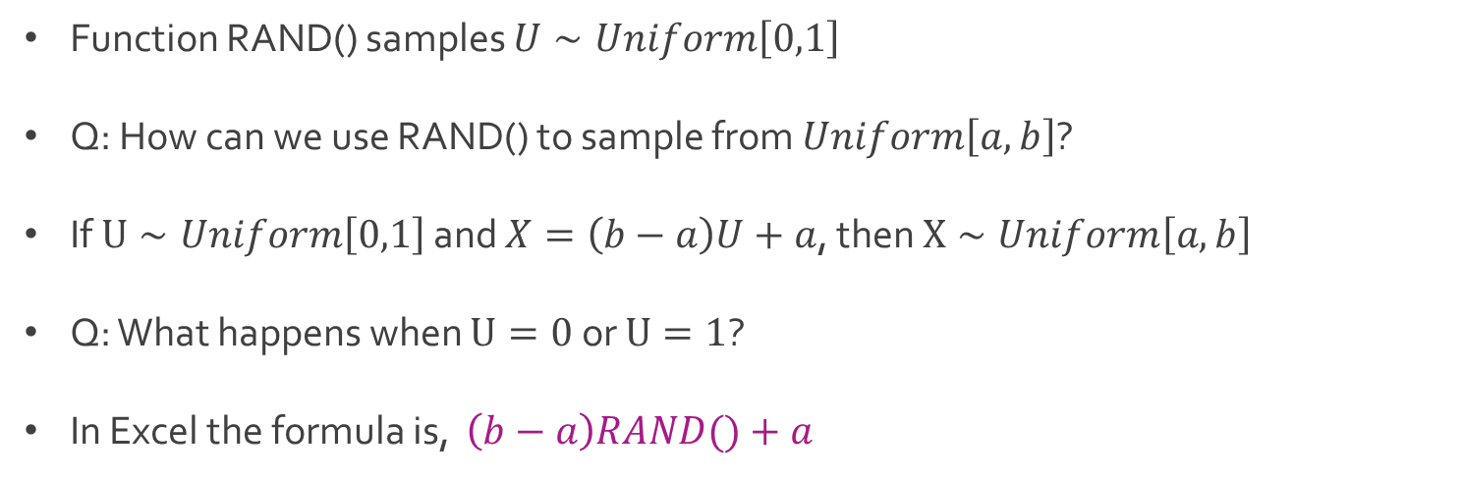
Uniform Simulation
Function RAND() samples $U∼Uniform\left[0,1\right]$
Q: How can we use RAND() to sample from $Uniform\left[a,b\right]$?
If $U∼Uniform\left[0,1\right]$ and $X=\left(b−a\right)U+a$, then $X∼Uniform\left[a,b\right]$
Q: What happens when $U=0$ or $U=1$?
In Excel the formula is, $\left(b−a\right)RAND()+a$

Slide 6

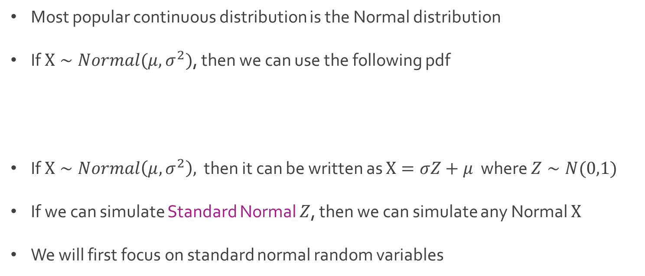
Normal Simulation
Most popular continuous distribution is the Normal distribution
If $X∼Normal(μ, σ^{2})$, then we can use the following pdf
If $X∼Normal\left(μ, σ^{2}\right),$ then it can be written as $X=σZ+μ$ where $Z∼N(0,1)$
If we can simulate Standard Normal $Z$, then we can simulate any Normal $X$
We will first focus on standard normal random variables

Slide 7

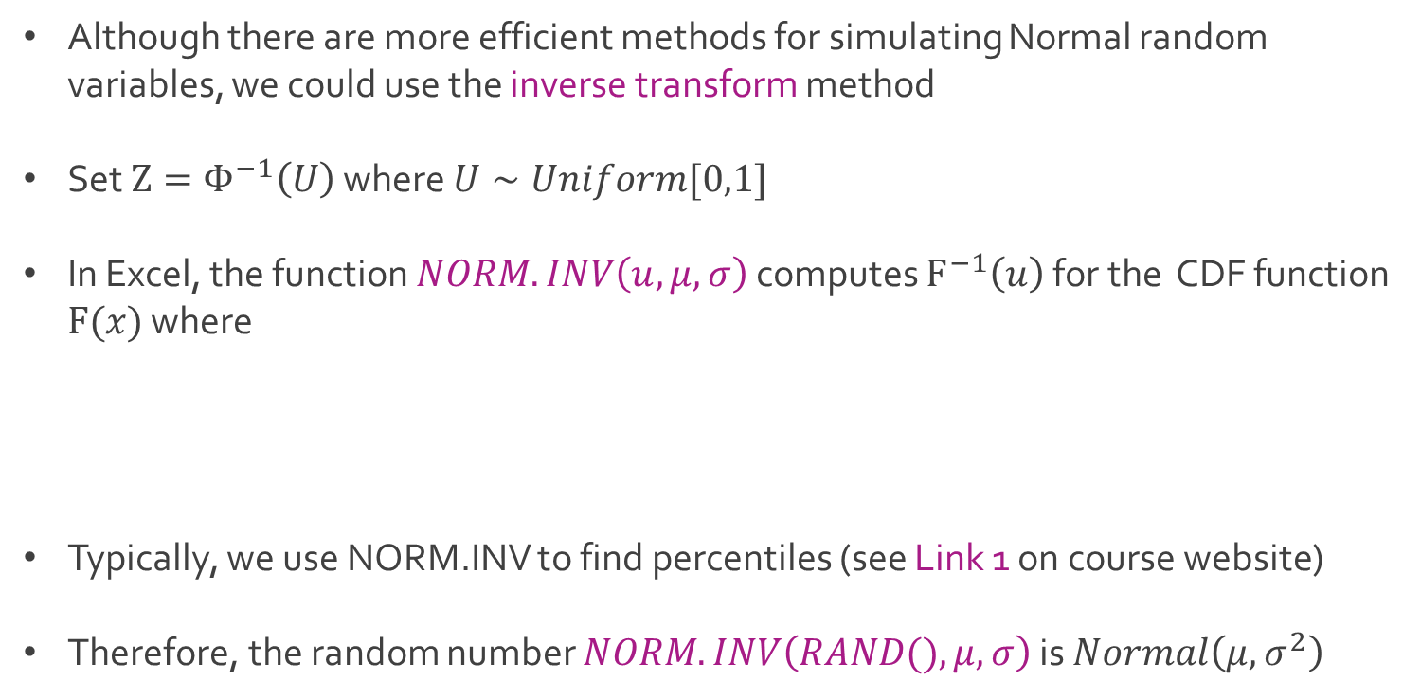
Normal Simulation
Although there are more efficient methods for simulating Normal random variables, we could use the inverse transform method
Set $Z=Φ^{−1}\left(U\right)$ where $U∼Uniform[0,1]$
In Excel, the function $NORM.INV\left(u, μ, σ\right)$ computes $F^{−1}\left(u\right)$ for the CDF function $F(x)$ where
Typically, we use NORM.INV to find percentiles (see Link 1 on course website)
Therefore, the random number $NORM.INV\left(RAND(), μ, σ\right)$ is $Normal\left(μ,σ^{2}\right)$

Slide 8
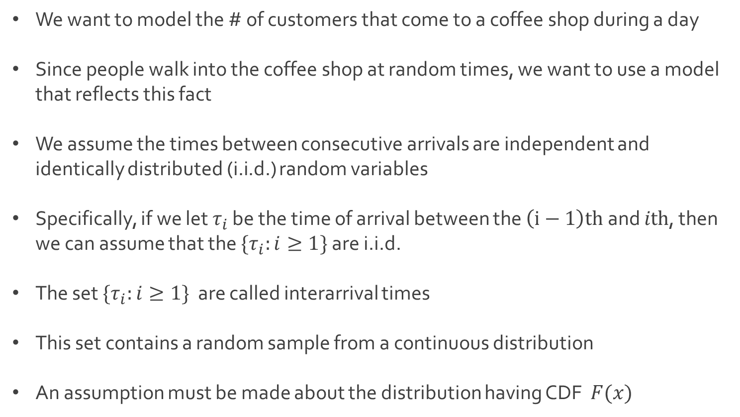
Ex: Arrival Process
We want to model the # of customers that come to a coffee shop during a day
Since people walk into the coffee shop at random times, we want to use a model that reflects this fact
We assume the times between consecutive arrivals are independent and identically distributed (i.i.d.) random variables
Specifically, if we let $τ_{i}$ be the time of arrival between the $\left(i−1\right)th$ and $ith$, then we can assume that the $\{τ_{i}:i≥1\}$ are i.i.d.
The set $\{τ_{i}:i≥1\}$ are called interarrival times
This set contains a random sample from a continuous distribution
An assumption must be made about the distribution having CDF $F(x)$

Slide 9
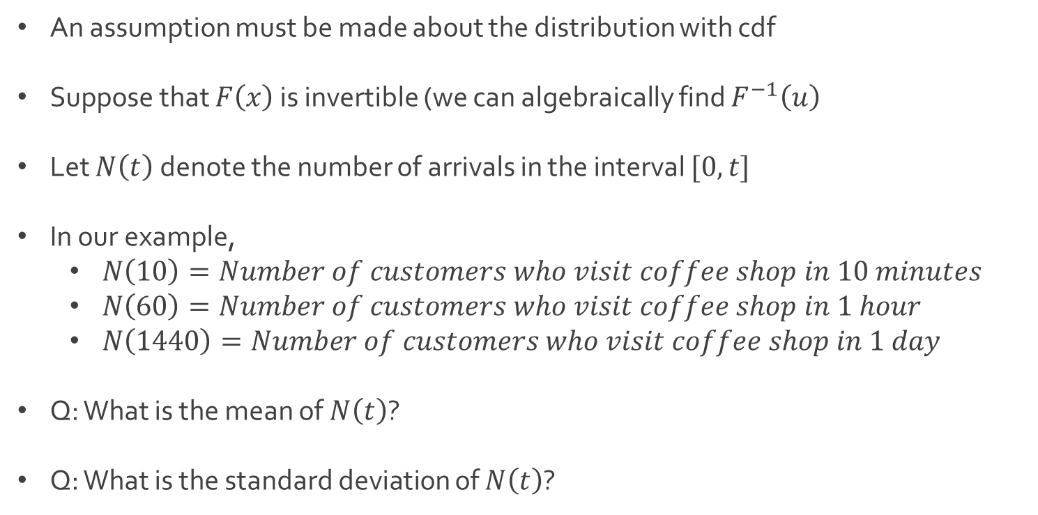
Ex: Arrival Process
An assumption must be made about the distribution with cdf
Suppose that $F\left(x\right)$ is invertible (we can algebraically find $F^{−1}\left(u\right)$
Let $N\left(t\right)$ denote the number of arrivals in the interval $[0,t]$
In our example,
$N\left(10\right)=Number of customers who visit coffee shop in 10 minutes$
$N\left(60\right)=Number of customers who visit coffee shop in 1 hour$
$N\left(1440\right)=Number of customers who visit coffee shop in 1 day$
Q: What is the mean of $N\left(t\right)$?
Q: What is the standard deviation of $N\left(t\right)$?

Slide 10
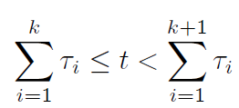
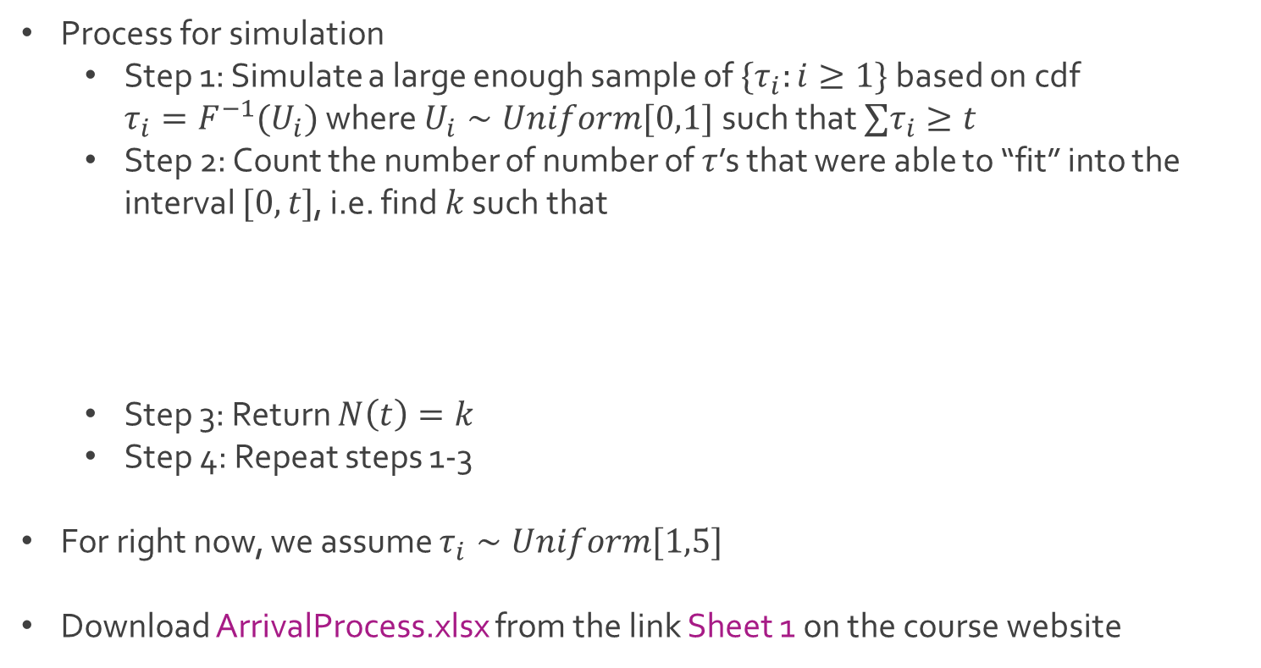
Ex: Arrival Process
Process for simulation
Step 1: Simulate a large enough sample of $\{τ_{i}:i≥1\}$ based on cdf ${τ_{i}=F}^{−1}(U_{i})$ where $U_{i}∼Uniform[0,1]$ such that $∑τ_{i}≥t$
Step 2: Count the number of number of $τ$’s that were able to “fit” into the interval $[0,t]$, i.e. find $k$ such that
Step 3: Return $N\left(t\right)=k$
Step 4: Repeat steps 1-3
For right now, we assume $τ_{i}∼Uniform[1,5]$
Download ArrivalProcess.xlsx from the link Sheet 1 on the course website

Slide 11
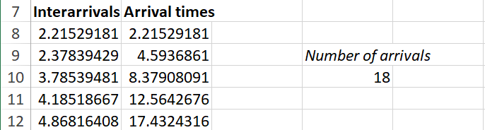
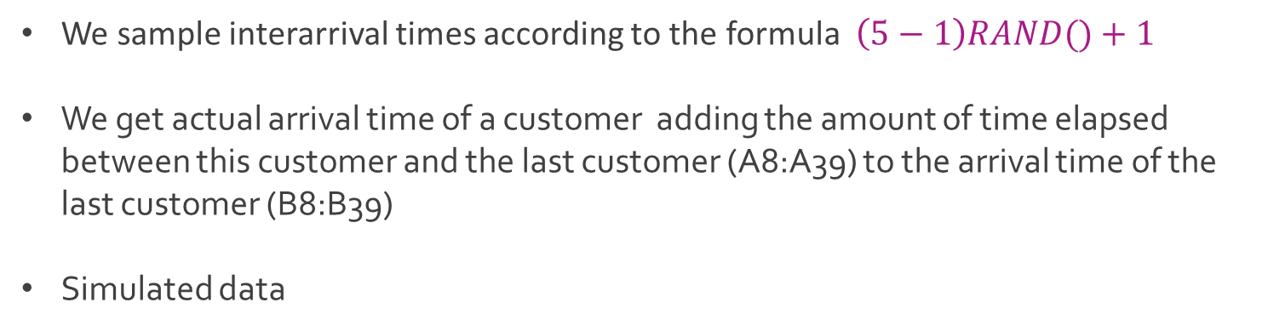
Ex: Arrival Process
We sample interarrival times according to the formula $\left(5−1\right)RAND()+1$
We get actual arrival time of a customer adding the amount of time elapsed between this customer and the last customer (A8:A39) to the arrival time of the last customer (B8:B39)
Simulated data

Slide 12
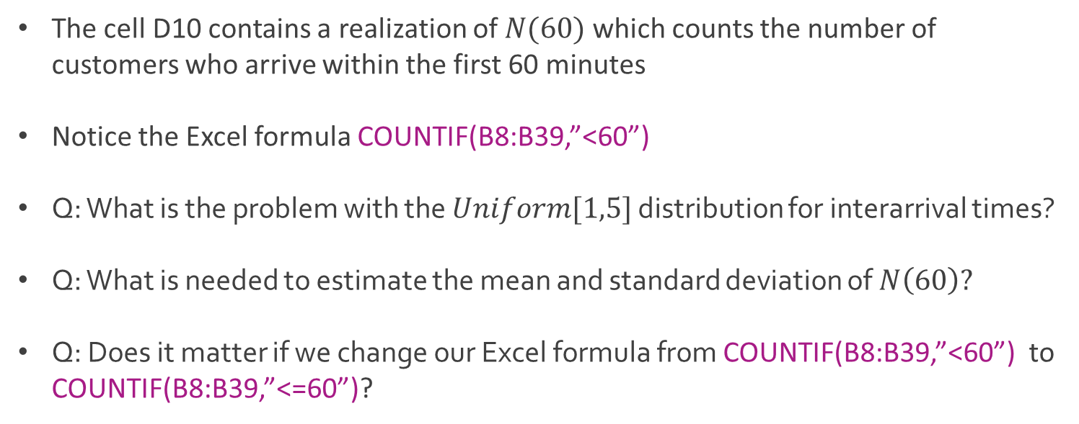
Ex: Arrival Process
The cell D10 contains a realization of $N(60)$ which counts the number of customers who arrive within the first 60 minutes
Notice the Excel formula COUNTIF(B8:B39,”<60”)
Q: What is the problem with the $Uniform[1,5]$ distribution for interarrival times?
Q: What is needed to estimate the mean and standard deviation of $N\left(60\right)?$
Q: Does it matter if we change our Excel formula from COUNTIF(B8:B39,”<60”) to COUNTIF(B8:B39,”<=60”)?

Slide 13
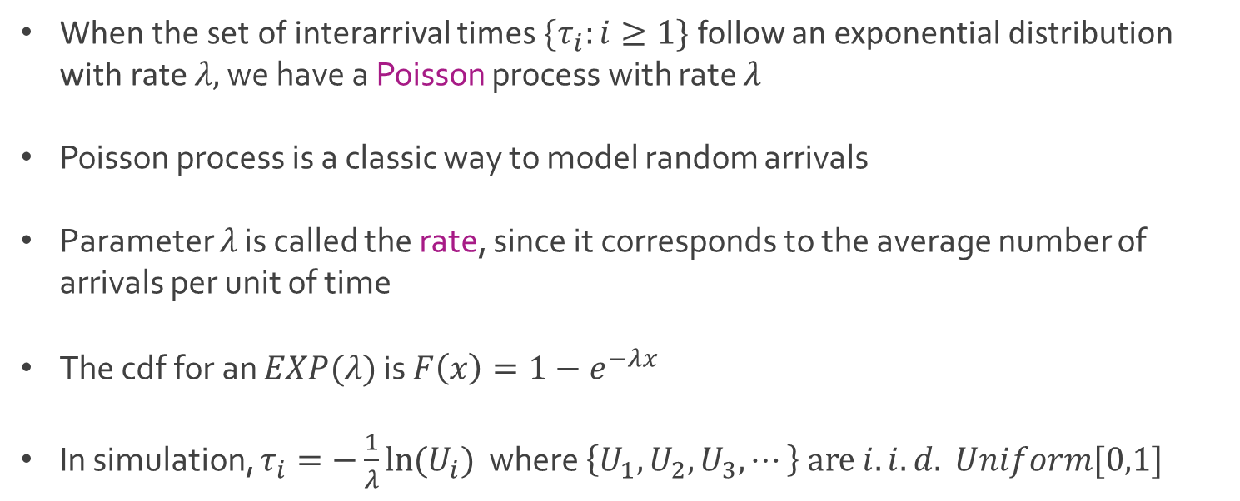
Poisson Process
When the set of interarrival times $\{τ_{i}:i≥1\}$ follow an exponential distribution with rate $λ,$ we have a Poisson process with rate $λ$
Poisson process is a classic way to model random arrivals
Parameter $λ$ is called the rate, since it corresponds to the average number of arrivals per unit of time
The cdf for an $EXP(λ)$ is $F\left(x\right)=1−e^{−λx}$
In simulation, $τ_{i}=−\frac{1}{λ}ln⁡(U_{i})$ where $\left\{U_{1},U_{2},U_{3},⋯\right\} are i.i.d. Uniform[0,1]$

Slide 14
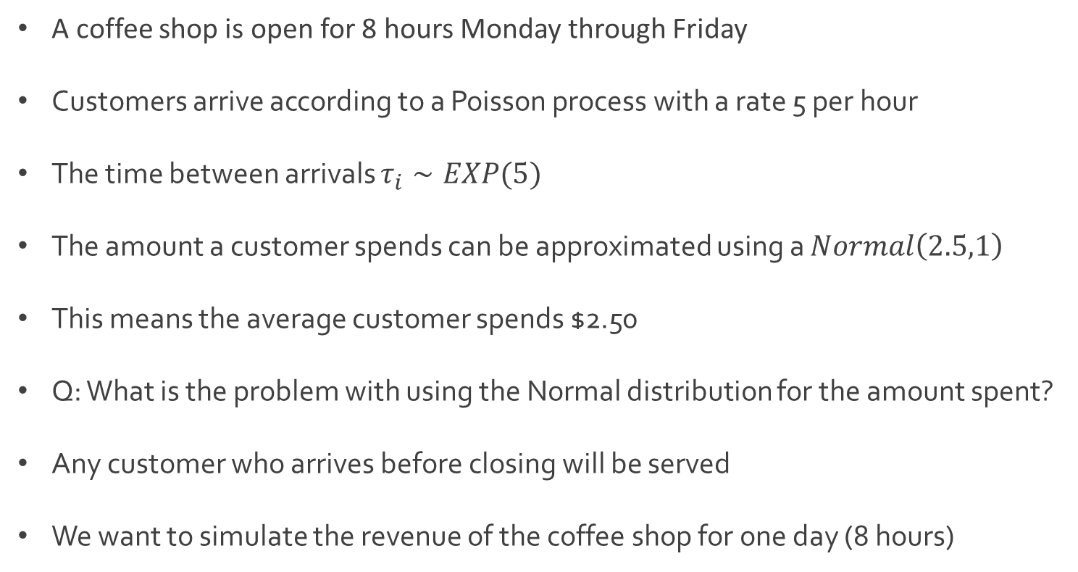
Ex: Coffee Shop Revenue
A coffee shop is open for 8 hours Monday through Friday
Customers arrive according to a Poisson process with a rate 5 per hour
The time between arrivals $τ_{i}∼EXP(5)$
The amount a customer spends can be approximated using a $Normal\left(2.5,1\right)$
This means the average customer spends $2.50
Q: What is the problem with using the Normal distribution for the amount spent?
Any customer who arrives before closing will be served
We want to simulate the revenue of the coffee shop for one day (8 hours)

Slide 15

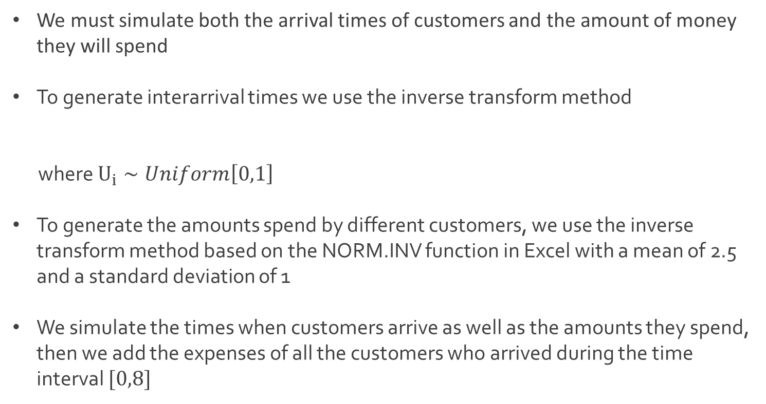
Ex: Coffee Shop Revenue
We must simulate both the arrival times of customers and the amount of money they will spend
To generate interarrival times we use the inverse transform method
where $U_{i}∼Uniform\left[0,1\right]$
To generate the amounts spend by different customers, we use the inverse transform method based on the NORM.INV function in Excel with a mean of 2.5 and a standard deviation of 1
We simulate the times when customers arrive as well as the amounts they spend, then we add the expenses of all the customers who arrived during the time interval $[0,8]$
$τ_{i}=−\frac{1}{5}ln⁡(U_{i})$

Slide 16
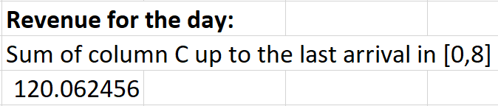
Ex: Coffee Shop Revenue
Download CoffeeShop.xlsx from the link Sheet 2 on the course website
Focus on tab named Revenue
Descriptions of columns
Column A contains interarrival times
Column B contains arrival times (notice the calculation)
Column C contains the amount spent (notice the use of MAX() function
Column D checks to see if the customer made it by closing
Simulated revenue for a single day

Slide 17

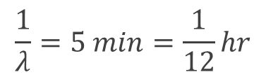
Ex: Coffee Shop Queue
Same coffee shop from previous example
We want to simulate the customer queue
Assume there is only one person at the cash register, and that this person both takes the order and prepares the coffee
Moment of silence for this poor worker
Each customer takes a random amount of time to be served, which we model as an exponential random variable with mean of 5 minutes (1/12 hour)
Customers are served in a first-come-first-serve basis
$$\frac{1}{λ}=5 min=\frac{1}{12}hr$$
$$λ=12$$

Slide 18

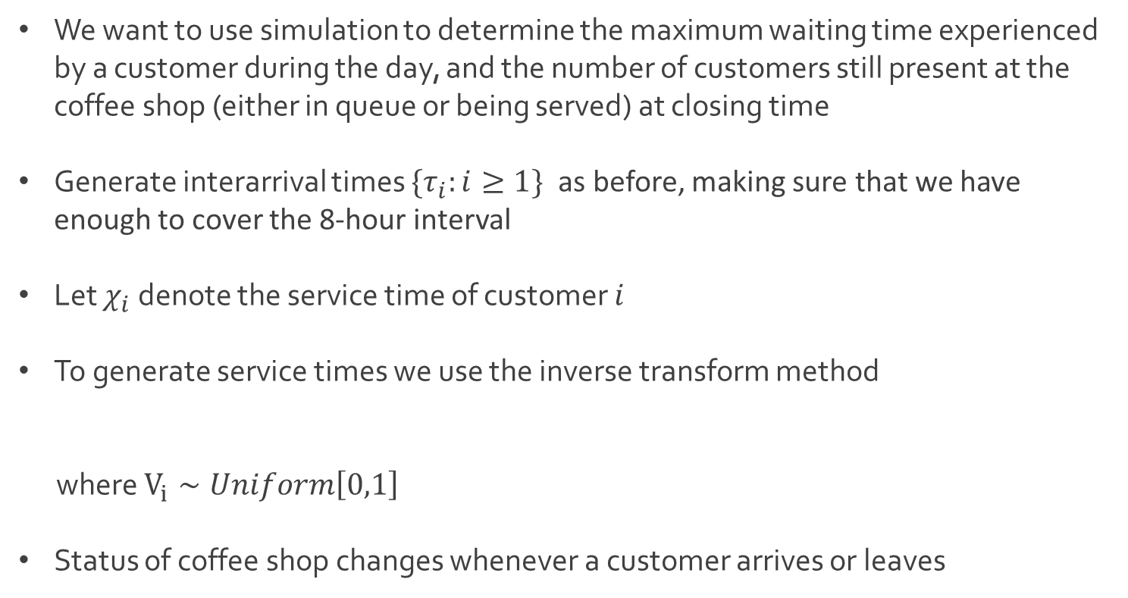
Ex: Coffee Shop Queue
We want to use simulation to determine the maximum waiting time experienced by a customer during the day, and the number of customers still present at the coffee shop (either in queue or being served) at closing time
Generate interarrival times $\{τ_{i}:i≥1\}$ as before, making sure that we have enough to cover the 8-hour interval
Let $χ_{i}$ denote the service time of customer $i$
To generate service times we use the inverse transform method
where $V_{i}∼Uniform\left[0,1\right]$
Status of coffee shop changes whenever a customer arrives or leaves
$χ_{i}=−\frac{1}{12}ln⁡(V_{i})$

Slide 19

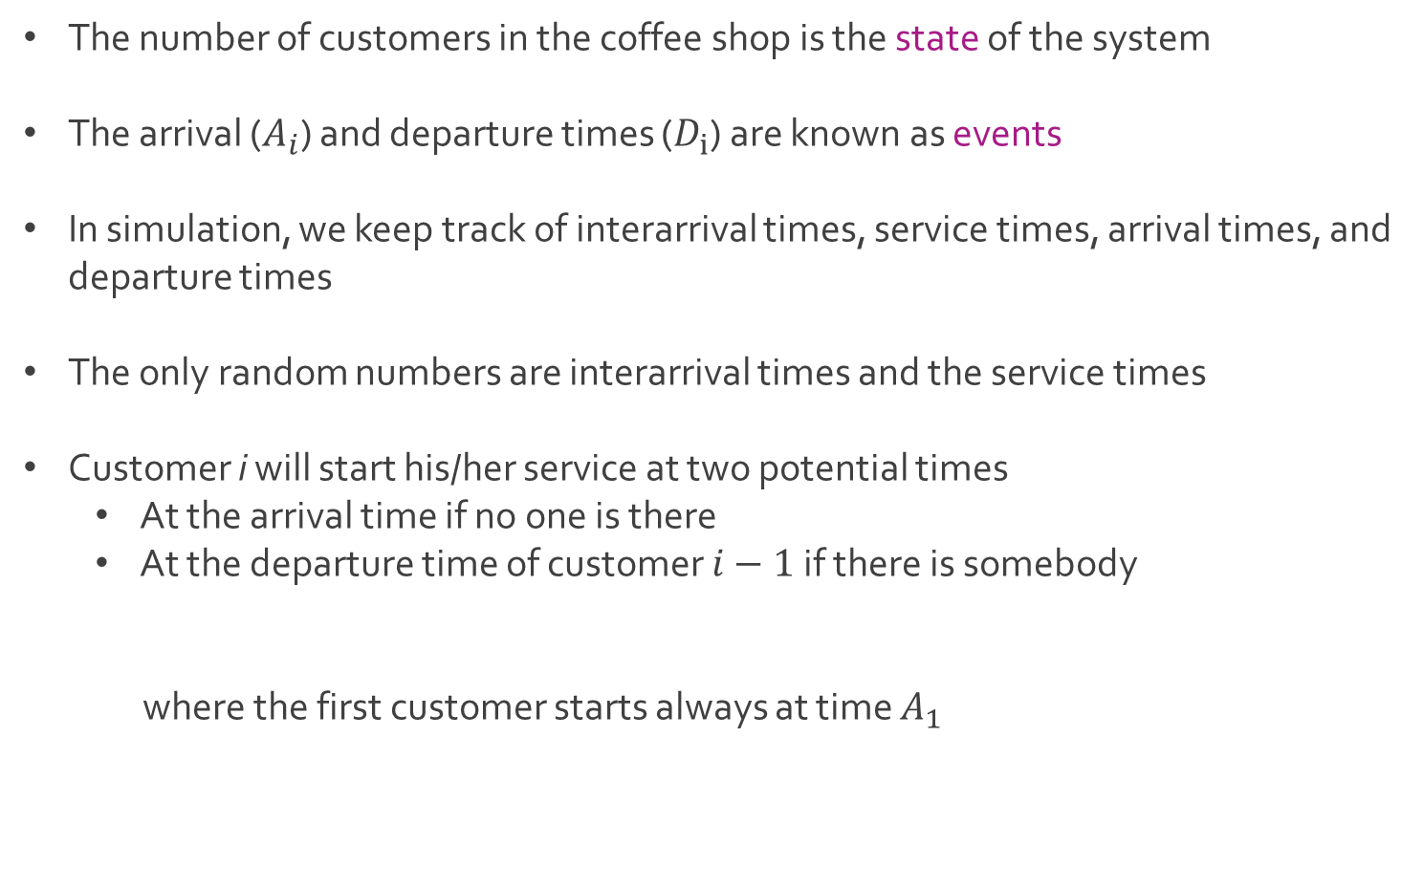
Ex: Coffee Shop Queue
The number of customers in the coffee shop is the state of the system
The arrival ($A_{i}$) and departure times ($D_{i}$) are known as events
In simulation, we keep track of interarrival times, service times, arrival times, and departure times
The only random numbers are interarrival times and the service times
Customer i will start his/her service at two potential times
At the arrival time if no one is there
At the departure time of customer $i−1$ if there is somebody
where the first customer starts always at time $A_{1}$

Slide 20
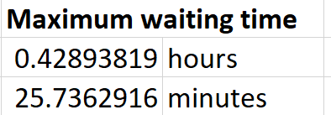
Ex: Coffee Shop Queue
The number of customers in the coffee shop at the end of the day is
Download CoffeeShop.xlsx from the link Sheet 2 on the course website
Focus on tab named Queue
Notice that departure time is the sum of arrival time and service time
Column H shows the waiting times which is the difference between the start of service and arrival time
$$Number of Arrivals in \left[0,8\right]−Number of Departures[0,8]$$

Slide 21
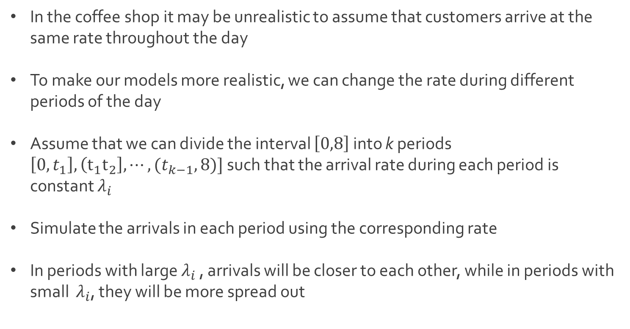
Ex: Coffee Shop Queue
In the coffee shop it may be unrealistic to assume that customers arrive at the same rate throughout the day
To make our models more realistic, we can change the rate during different periods of the day
Assume that we can divide the interval $\left[0,8\right]$ into k periods $\left[0,t_{1}\right], \left(t_{1}t_{2}\right], ⋯,(t_{k−1},8)]$ such that the arrival rate during each period is constant $λ_{i}$
Simulate the arrivals in each period using the corresponding rate
In periods with large $λ_{i}$ , arrivals will be closer to each other, while in periods with small $λ_{i}$, they will be more spread out

Slide 22




The End
Dale

